Slide 1

TRANSLATING TELUGU WORD IMAGE TO ITS MEANINGFUL ENGLISH WORD AS SPEECH
Github Link: https://github.com/BhavanaDosti/A15
Batch No: A-15 Project Guide:
D. Bhavana (164G1A0515) Mrs.S.L.Sailaja,M.Tech
N. Harika (164G1A0528) Assistant Professor.
Arbaaz Dilkush Mohammad(164G1A0506)
M . Lakshmi Madhav krishna (164G1A0545)
Srinivasa Ramanujan Institute of Technology
Department of Computer Science & Engineering

Slide 2
Contents
Abstract
Problem Statement
Literature Survey
Proposed System
Project Planning
Requirements
Limitations
Design
Implementation
Future Scope
References
Previous Review Queries

Slide 3
Abstract
Telugu is the language spoken by more than 100 million people in South India. Telugu script consists of rounded characters with no horizontal and vertical lines as in Hindi script.
Here, in our project, the Telugu word image can be given as input and its Meaningful English speech as output.
The objective of the project is to translate the digitalized Telugu word image to its Meaningful English word as speech.

Slide 4
Problem Statement
There are 56 characters and several compound characters are possible in Telugu.
The objective of this work is to recognize the basic words of Telugu and convert it into English Speech. Due to the Erosion and Dilation, errors of some words could not be recognized by this system but overall performance of the system with clean background will results good.

Slide 5
Literature Survey
Existing System :
Currently, all the existing system works on foreign languages like Spanish, English, Chinese. In India, languages like Tamil, Hindi and Marathi are well known for this kind of development when compared with Telugu. Since Telugu is our regional language and due to some illiteracy problem, Telugu has been selected for this project.

Slide 6
Contd…
“A Study on Recognition Methods of Telugu Numerals and Characters”, Ch. N. Manisha, E. Sreenivasa Reddy, Y.K. Sundara Krishna.
Recognition of Characters in digital data is a very big challenging issue for the researchers. Recognition of printed Telugu digital documents is a more complicated issue. The digital format of hardcopy of a document is called document image. This paper analyzes the various methods to recognize the numerals and characters of Telugu language.

Slide 7
Proposed System
We are proposing a model which will take images with Telugu words in it and then convert it into its Meaningful English speech as output.
Advantages:
People who are unable to understand Telugu, like tourists and what to understand our culture and monuments, this model can help them read and understand Telugu posts.

Slide 8
Project Planning
Time Schedule
TASK | DATE
Software Installation & Requirements Gathering | 27-01-2020
Analysis & Design | 05-02-2020
Implementation | 28-02-2020
Testing | 20-03-2020
Documentation & Verification | 05-04-2020

Slide 9
Requirements
Software Requirements:
Operating Systems - Windows, Linux
Platform - Python 3.7
Programming - Python
Hardware Requirements:
i3 processor
4GB RAM

Slide 10
Limitations
The input image should not exceed the dimensions of 400 * 600.
The image with one word performs good.
The image should be in .png or .jpeg format.
In-built dataset is used.

Slide 11
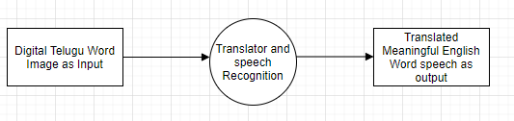
Design
Data Flow Diagram(DFD) : Level-0

Slide 12
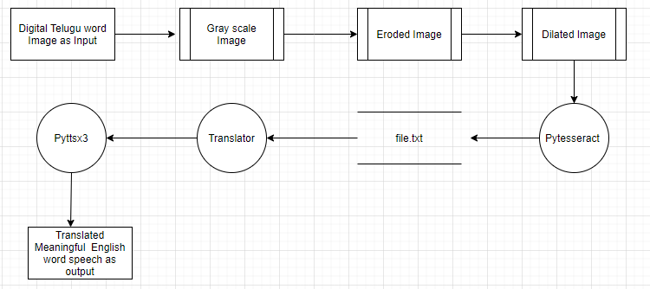
Contd…
DFD Level-1

Slide 13
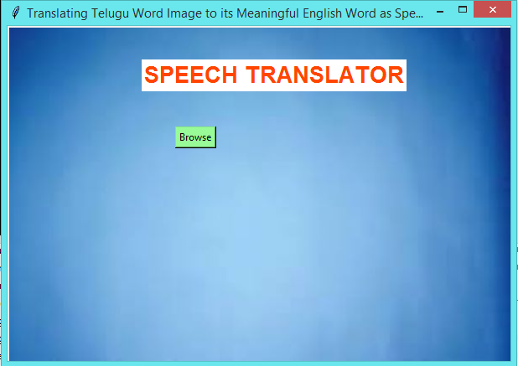
Implementation
Our project is an attempt to recognize the Telugu text of an image and to convert into its Meaningful English speech. Here we have to upload the image and it will convert the Telugu text to its meaningful English speech.
Step 1 : After Running the application can see the Template of the Project.

Slide 14
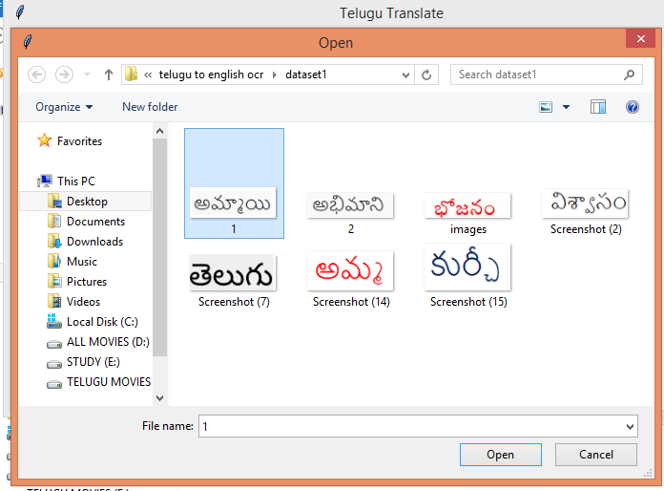
Contd…
Step 2 : When we click on Browse button to upload the image ,then we have to select on image from the location.

Slide 15

Contd…
1.jpeg
The image that we are uploading should have the dimensions of upto 400 X 600.
The image should be in the .png or .jpeg format.

Slide 16
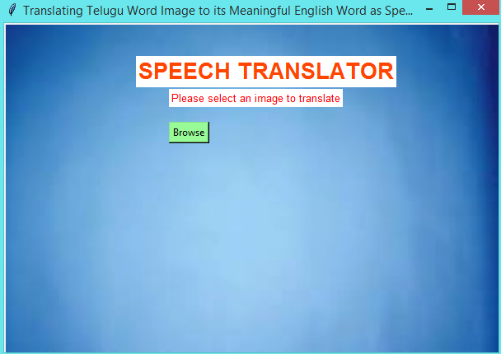
Contd…
If we does not select any image ,it will display an alert message as “Please select an image to translate” .

Slide 17
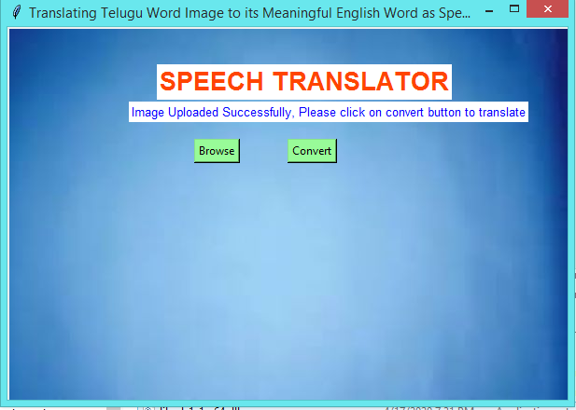
Contd…
Step 3 : After uploading the image, the application will enables the convert Button.

Slide 18
Contd…
After clicking on the convert button the internal process undergoes as below.
PYTESSERACT
Python-tesseract is an optical character recognition (OCR) tool for python. That is, it will recognize and “read” the text embedded in images.

Slide 19
Contd…
TRANSLATOR
Googletrans is a free and unlimited python library that implemented Google Translate API. This uses the Google Translate Ajax API to make calls to such methods as detect and translate.
Originally centered around statistical machine translation, it worked by translating the required text first into English as an intermediary step language and then into the target language and vice-versa.
PYTTSX3
Pyttsx3 is a text-to-speech conversion library in Python. Unlike alternative libraries, it works offline, and is compatible with both Python 2 and 3.

Slide 20
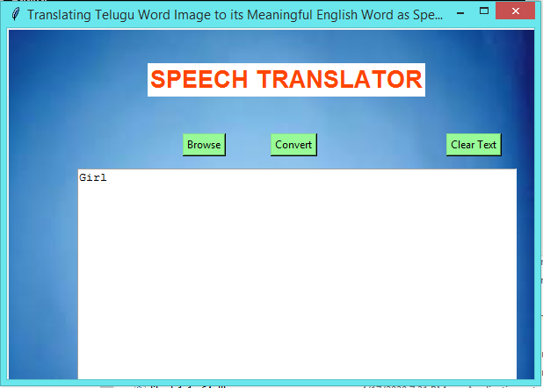
Contd…
Step 4 : After processing the image, we can see the English word output of the input Telugu image and we can able to hear the voice of the output.
OUTPUT OF GIVEN TELUGU WORD IMAGE:

Slide 21
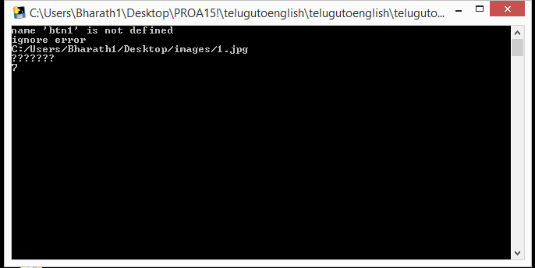
Contd…
The console of the project looks like:

Slide 22
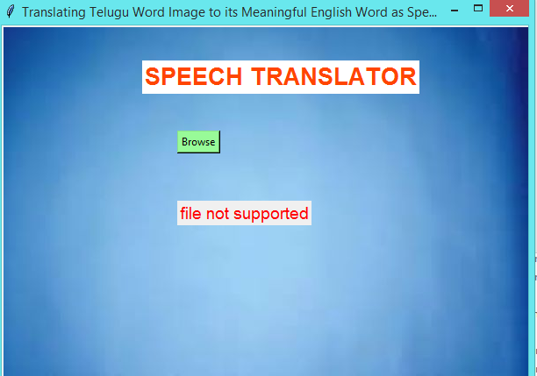
Contd…
Step 5 :If any other type of file rather than .jpg or .png is attached then we can see the alert message as “ file not supported”.

Slide 23
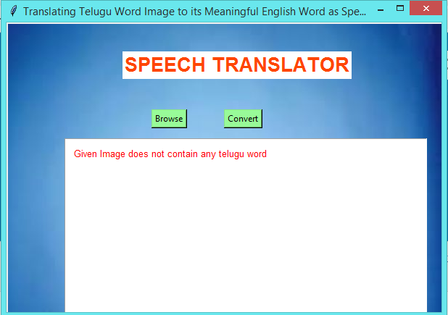
Contd…
Step 6 :If the given image doesn't contain any Telugu word ,we can see the output as “Given image does not contain any Telugu word.

Slide 24
Future Scope
The external images that can capture from Mobile phones ie.Android app, is the future scope of the project.

Slide 25
Previous Review Queries
Change the Title. (Digitalized or Image)
Dimensions of the Image.
Limitations should mention in the ppt.
Input of the project (Digitalized or Handwritten).
Mention the algorithm technique that are using in the project.

Slide 26
REFERENCES
[1] Jawahar, C. V., MNSSK Pavan Kumar, and SS Ravi Kiran. "A bilingual OCR for Hindi-Telugu documents and its applications." Document Analysis and Recognition, 2003.Proceedings. Seventh International Conference on. IEEE,2003.
[2] Babu, Arja Rajesh. OCR for Printed Telugu Documents. Diss. Indian Institute of Technology Bombay Mumbai, 2014.
[3] Hu, Peifeng, et al. "Recognition of gray character using gabor ﬁlters." Information Fusion, 2002. Proceedings of the Fifth International Conference on. Vol. 1. IEEE, 2002.
[4] Ramanathan, R., et al. "Robust feature extraction technique for optical character recognition." Advances in Computing, Control, & Telecommunication Technologies, 2009. ACT’09. International Conference on. IEEE, 2009.
[5] Naveen Sankaran, C.V Jawahar, "Recognition of Printed Devanagari Text Using BLSTM Neural Network", IEEE, 2012.
[6] Kavita R. Singh, Text Recognition from Images: A Review Pratik Madhukar Manwatkar, YCCE, Nagpur:Department of Computer Technology, pp. 441.

Slide 27
THANK YOU
Queries
?

